Slide 1
Modeling Electrocardiography Cyclicity with Interpretable Beat Representation Learning
Xiaoyu Li, Xi’an Jiaotong University
Supervised by:
Prof. Buyue Qian, Xi’an Jiaotong University
Dr. Jishang Wei, HP Lab

Slide 2
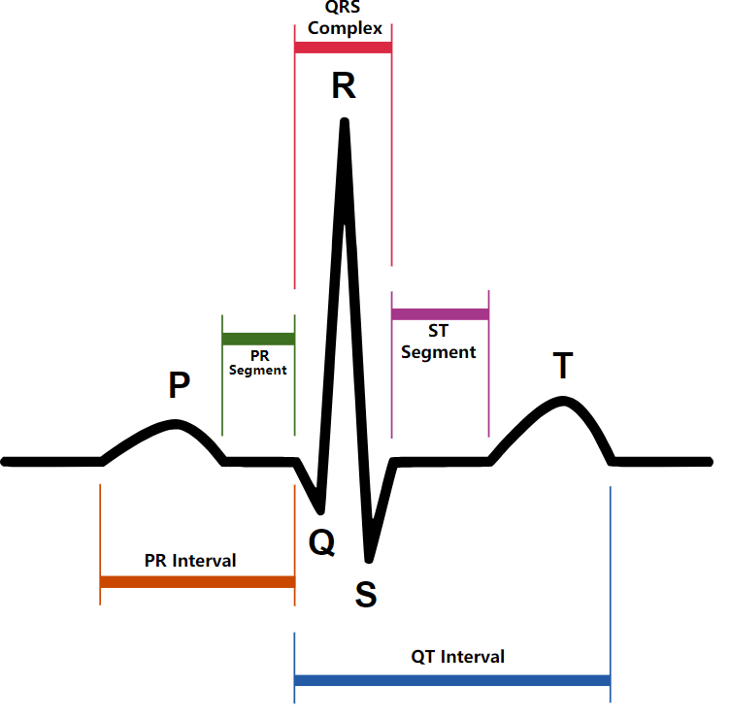
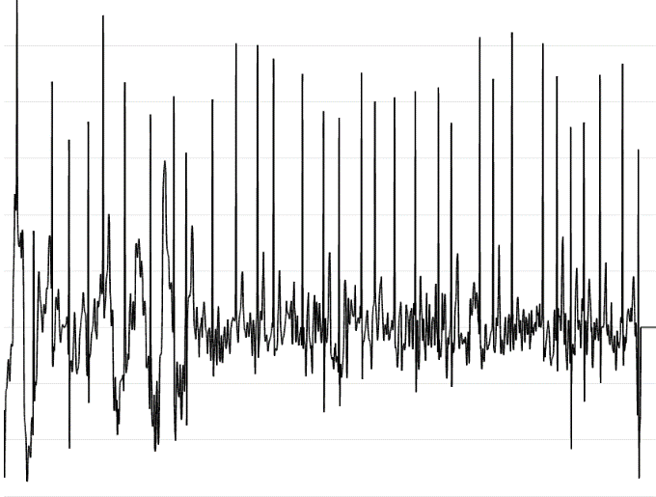
Background
Standard ECG for one beat
Real ECG for 60s
Indispensable tool to monitor hearts’ electronic activities.2
labor-intensive process to check for cardiologists.

Slide 3
Motivation
Various deep learning techniques have been applied on ECG, including LSTM, 1-D CNN, attention mechanism, ResNet… But there are still two aspects where more attention is need:
The cyclicity modeling of the variable-length beats, since cyclicity is a significant nature of ECG according to domain knowledge but almost ignored in previous work.
The very limited amount of valuable data, due to the individual variation.

Slide 4
Motivation
Various deep learning techniques have been applied on ECG, including LSTM, 1-D CNN, attention mechanism, ResNet… But there are still two aspects where more attention is need:
The cyclicity modeling of the variable-length beats, since cyclicity is a significant nature of ECG according to domain knowledge but almost ignored in previous work.
Treat ECG beat by beat
The very limited amount of valuable data, due to the individual variation.
Unsupervised learning
To Model ECG Cyclicity with Interpretable Beat Representation Learning

Slide 5
Model
Previous methods
1-D CNN,
LSTM
CNN-LSTM
LSTM-Attention
ResNet
…
Neural Network

Slide 6
Model
Our framework
s₁
s₂
s_{n}
R-peak
R-peak
R-peak
R-peak
R-peak Extractor

Slide 7
Model
Neural Network
Our framework
v₁
v₂
v_{n}
Encoder
Encoder
Encoder
s₁
s₂
s_{n}
R-peak
R-peak
R-peak
R-peak
R-peak Extractor

Slide 8
Model
Neural Network
Our framework
v₁
v₂
v_{n}
Encoder
Encoder
Encoder
s₁
s₂
s_{n}
R-peak
R-peak
R-peak
R-peak
R-peak Extractor

Slide 9





Model
Beat representation learning
s
Sample
Generator(G)
P_{prior}(z)
z_{p}
s_{p}
/Decoder
$$μ$$
Encoder
Sample
$$c$$
Generator(G)
Discriminator(D)
$$z$$
Real/Fake
/Decoder
$$σ$$
s
s_{r}
Discriminator(Q)
$$cr$$

Slide 10
Model
Beat representation learning
s
Sample
Generator(G)
P_{prior}(z)
z_{p}
s_{p}
/Decoder
$$μ$$
Encoder
Sample
$$c$$
Generator(G)
Discriminator(D)
$$z$$
Real/Fake
/Decoder
$$σ$$
s
s_{r}
VAE-GAN structure to learn beyond element-wise reconstruction error
Discriminator(Q)
Info-GAN: mutual information maximization to enhance disentanglement, length of c to deal with the trade-off between disentanglement and performance.
$$cr$$

Slide 11
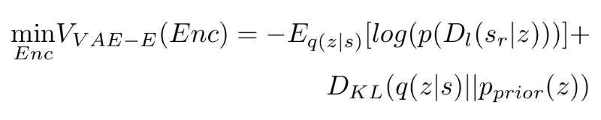
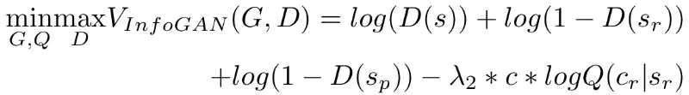
Model
Beat representation learning
D_{l} denotes the hidden representation of the l-th layer of the discriminator
Lambda1 is used to weight the ability to reconstruct vs. fooling the discriminator.
Lambda2 is used to weight the variational regularization of mutual information.

Slide 12
Conclusion
1. We propose a cycle-aware framework to model the variate-length cycles in ECG signals, transforming ECG time series signal to sequence of beat representations. In this way, different aspects are possible to be aligned along the time axis, which helps downstream tasks.
2. We propose an unsupervised learning method combining VAE with Info-GAN. GAN's discriminator helps VAE generate real samples beyond the limitation of element-wise reconstruction error. Info-GAN not only enhance the disentanglement of representation with mutual information maximization, but also help control the balance between the disentanglement and the performance with the length of interpretable latent code.
3. We demonstrate the learned distengled dimensions of beat representation and also show the priority of our framework over directly applying neural network to raw input.

Slide 13
Thanks
You are welcome to contact us !
xiaoyuli@stu.xjtu.edu.cn

